Slide 1

Galatians
The Christian’s Declaration of Independence

Slide 2
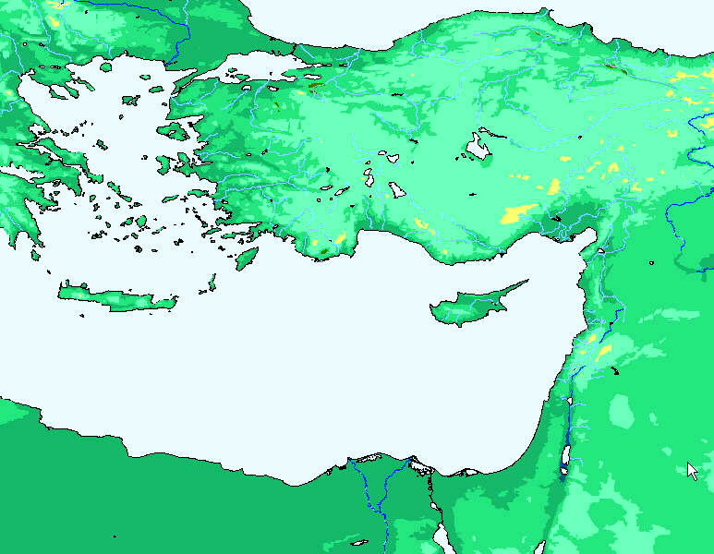
Galatia

Slide 3
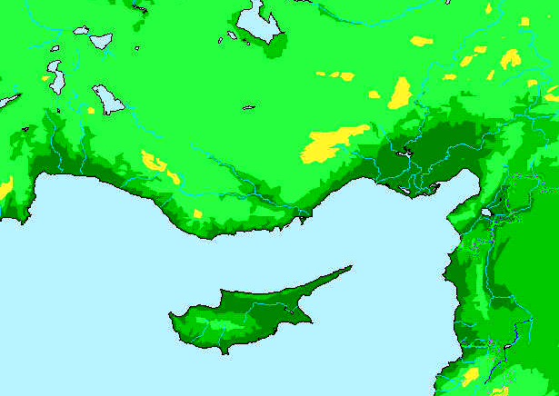
●
Tarsus
Syrian
Antioch
●
●
Seleucia
● Salamis
●
Paphos

Slide 4
Syrian
● Antioch
● Perga
●
Tarsus
Syrian
Antioch
●
●
Seleucia
● Salamis
●
Paphos

Slide 5
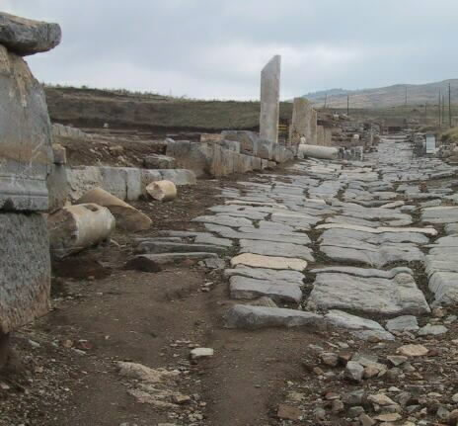
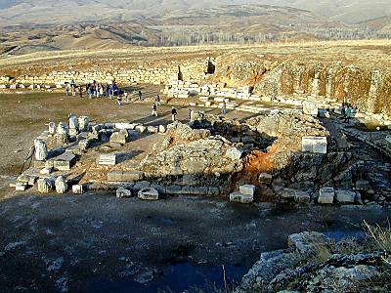
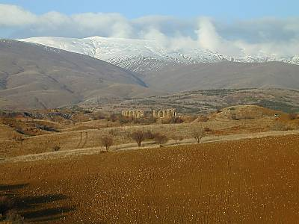
Antioch in
Psidia
Temple of Augustus

Slide 6
Pisidian
● Antioch
● Iconium
Lystra 
● Derbe
● Perga
●
Tarsus
Syrian
Antioch
●
●
Seleucia
● Salamis
●
Paphos

Slide 7
The Question
How does one become right with God?
Faith in Christ alone
Faith in Christ plus circumcision

Slide 8
Galatians
Chapters 1-2 | Chapters 3-4 | Chapters 5-6
History | Doctrine | Practice
Vindication | Exposition | Application
Paul’s Apostleship and his Gospel come from the Lord | Man is Justified through Faith Alone | We are to walk by Faith and Love
Testimonial and Apologetical | Doctrinal and Argumentative | Practical and Encouraging
Source of the Gospel | Defense of the Gospel | Application of the Gospel
The Gospel is from God, “not according to man” (1:11) | The Gospel is Superior to the Law in what it is able to Accomplish | The Gospel of the Spirit: Live by the Spirit Walk by the Spirit

Slide 9
Style of Writing
This epistle is short and to the point. Its style is abrupt, passionate and full of strong emotion.
I am amazed that you are so quickly deserting Him (1:6).
If any man is preaching to you a gospel contrary to what you received, he is to be accursed! (1:9).
You foolish Galatians, who has bewitched you? (3:1).
Are you so foolish? (3:3).
I wish that those who are troubling you would even mutilate themselves (5:12).

Slide 10
Romans
Galatians
Calm reflection
Passionate, emotional
Christianity in the study
Christianity on the battlefield
Later Epistle
Earlier Epistle
Justification by faith set forth systematically
Justification by faith defended from attacks
Our Constitution
Our Declaration of Independence

Slide 11
Galatians 1:6-9
6 I am amazed that you are so quickly deserting Him who called you by the grace of Christ, for a different gospel; 7 which is really not another; only there are some who are disturbing you, and want to distort the gospel of Christ.
8 But even though we, or an angel from heaven, should preach to you a gospel contrary to that which we have preached to you, let him be accursed.
9 As we have said before, so I say again now, if any man is preaching to you a gospel contrary to that which you received, let him be accursed.

Slide 12
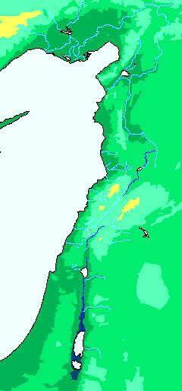
Paul and Jerusalem
●
Antioch
Paul’s Gospel did not come from Jerusalem (Chapter 1)
Paul’s Gospel did not change in Jerusalem (2:1-10)
Paul’s gospel was not changed by Jerusalem when they came to Antioch (2:11-16)
●
Jerusalem

Slide 13
Who has
Bewitched
You?
Does God give
the Spirit and
Miracles by the
Law or by Faith?
Did you receive
the Spirit by the
works of the
Law, or by
hearing with
faith?
Did you suffer
so many things
in vain?
Are you
so foolish?
Having begun by
the Spirit, are you
now being perfected
by the flesh?

Slide 14
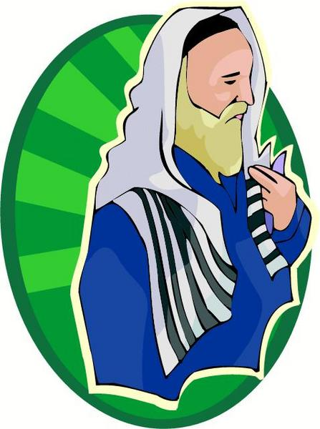
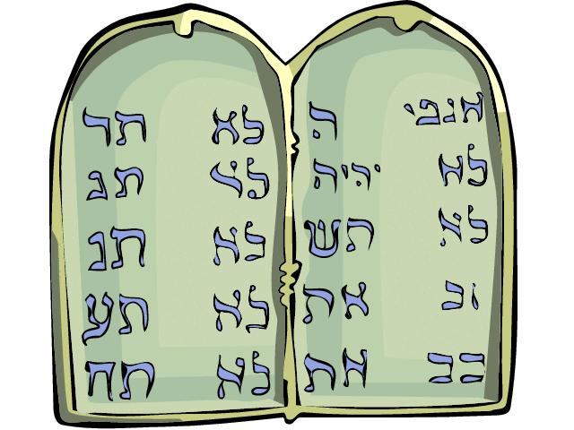

Salvation is
through faith
The evidence
of Abraham
The evidence
of Adoption
The evidence
from the Law
The evidence
of the Tutor
The evidence
of the Covenant
Promise

Slide 15
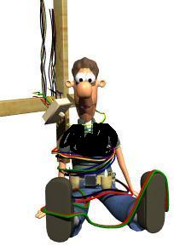

If you are free…
Don’t be entangled
in a yoke of bondage
Don’t turn your
Freedom into an
Opportunity for
The flesh
Walk by
the Spirit
Bear one
another’s
Burdens

